Slide 1

Dynamic programming II and NP-hard Proof
Yongcai Wang
Renmin University of China

Slide 2
1D数组上的动态规划
memoized-WIS(j) {
if (j == 0) return 0
else if (M[j] has been computed)
return M[j]
else {
leaveWeight = memoized-WIS(j-1)
takeWeight = v[j] + memoized-WIS(p[j])
if ( leaveWeight > takeWeight )
{
M[j] = leaveWeight
pred[j] = j-1
}
else
{
M[j] = takeWeight
pred[j] = p[j]
}
return M[j];
}
}
Weighted Interval Scheduling
The initial value: opt(0) = 0
opt(j) is related to sub-problem opt(j − 1) and opt(p(j)).
If we have the optimal values of opt(j − 1) and opt(p(j)), we can calculate opt(j).
Running time: O(n)

Slide 3
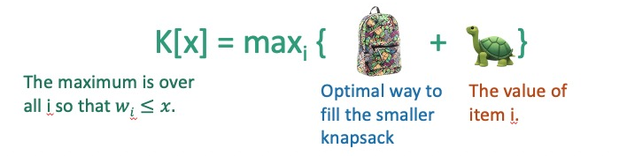
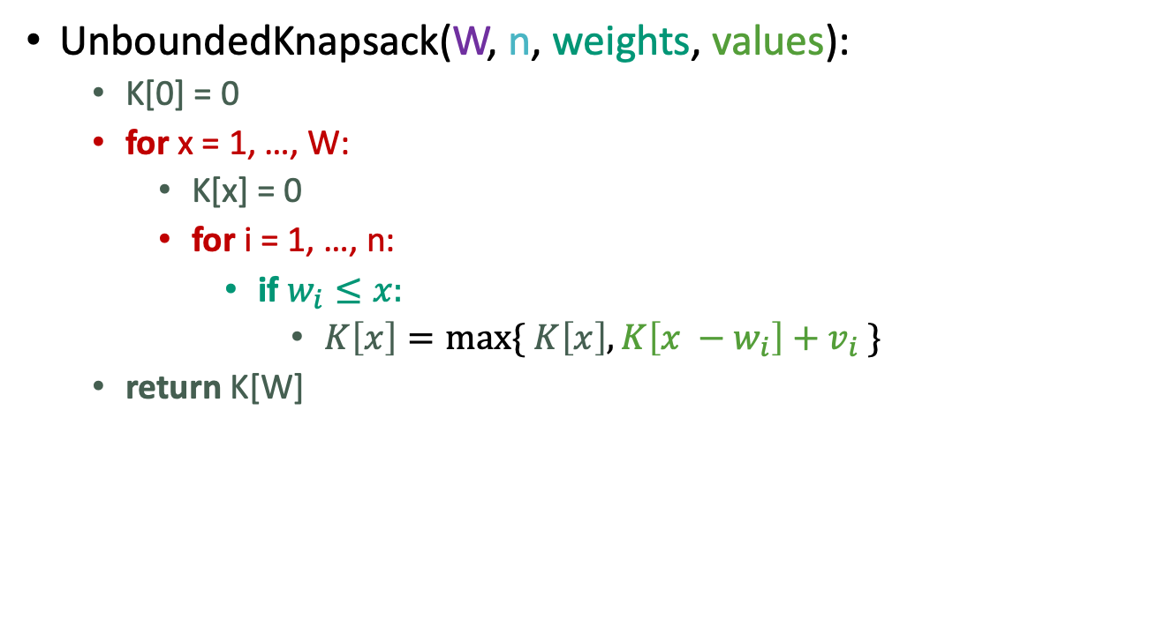
1D 数组价值函数表示，2D计算
无限背包问题
K[x] = max_{i} { K[x – w_{i}] + v_{i} }
UnboundedKnapsack(W, n, weights, values):
K[0] = 0
for x = 1, …, W:
K[x] = 0
for i = 1, …, n:
if $w_{i}≤x:$
$K\left[x\right]=\max{\{ K\left[x\right], K\left[x −w_{i}\right]+v_{i} \}}$
return K[W]
Running time: O(nW)

Slide 4
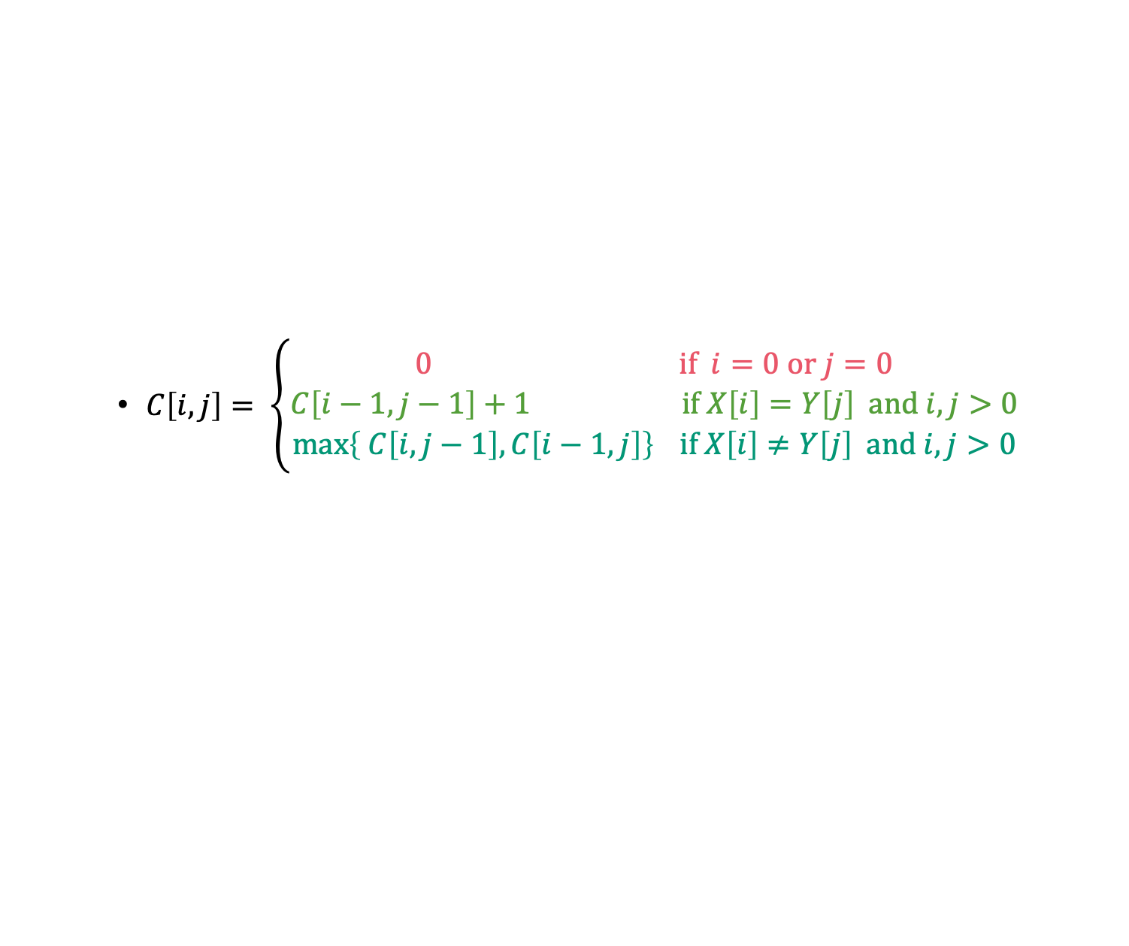
2D数组价值函数表示，2D计算
最长公共子序列LCS问题：
$C\left[i,j\right]= \left\{\begin{aligned}0 \text{if} i=0 \text{or} j=0 \\ C\left[i−1,j−1\right]+1 \text{if} X\left[i\right]=Y\left[j\right] \text{and} i,j>0 \\ \max\left\{ C\left[i,j−1\right], C\left[i−1,j\right]\right\} \text{if} X\left[i\right]≠Y\left[j\right] \text{and} i,j>0\end{aligned}\right.$
LCS(X, Y):
C[i,0] = C[0,j] = 0 for all i = 0,…,m, j=0,…n.
For i = 1,…,m and j = 1,…,n:
If X[i] = Y[j]:
C[i,j] = C[i-1,j-1] + 1
Else:
C[i,j] = max{ C[i,j-1], C[i-1,j] }
Return C[m,n]
Running time: O(nm)

Slide 5
2D数组价值函数表示，3D计算
矩阵链式乘法
Matrix-Chain(p[0..n]) {
m = array[1..n, 1..n]
s = array[1..n-1, 2..n]
for (i = 1 to n) m[i, i] = 0
for (L = 2 to n) {
for (i = 1 to n - L + 1) {
j=i+L-1
m[i,j] = INFINITY
for (k = i to j - 1) {
cost = m[i, k] + m[k+1, j] + p[i-1]*p[k]*p[j]
if (cost < m[i, j]) {
m[i, j] = cost
s[i, j] = k }
}
}
}
return m[1, n] (final cost) and s (splitting markers)
}
Running time: O(n³)

Slide 6
主要内容
0-1 Knapsack Problem
2D数组表示，2D计算
Maximal Independent Set, Minimal cover
树上的动态规划
Floyd-Warshall Algorithm
图上的动态规划
NP-hard problem

Slide 7
Item:
Weight:
6
2
4
3
11
Capacity: 10
Value:
20
8
14
13
35
Unbounded Knapsack:
Suppose I have infinite copies of all of the items.
What’s the most valuable way to fill the knapsack?
0/1 Knapsack:
Suppose I have only one copy of each item.
What’s the most valuable way to fill the knapsack?
Total weight: 10
Total value: 42
Total weight: 9
Total value: 35

Slide 8
Recipe for applying Dynamic Programming
Step 1: Identify optimal substructure.
Step 2: Find a recursive formulation for the value of the optimal solution.
Step 3: Use dynamic programming to find the value of the optimal solution.
Step 4: If needed, keep track of some additional info so that the algorithm from Step 3 can find the actual solution.
Step 5: If needed, code this up like a reasonable person.

Slide 9
Optimal substructure: try 1
Sub-problems:
Unbounded Knapsack with a smaller knapsack.
First solve the problem for small knapsacks
Then larger knapsacks
Then larger knapsacks

Slide 10
This won’t quite work…
We are only allowed one copy of each item.
The sub-problem needs to “know” what items we’ve used and what we haven’t.
I can’t use any turtles…

Slide 11
Optimal substructure: try 2
Sub-problems:
0/1 Knapsack with fewer items.
First solve the problem with few items
We’ll still increase the size of the knapsacks.
Then more items
Then yet more items
(We’ll keep a two-dimensional table).

Slide 12
Our sub-problems:
Indexed by x and j
First j items
Capacity x
K[x,j] = optimal solution for a knapsack of size x using only the first j items.

Slide 13
Relationship between sub-problems
Want to write K[x,j] in terms of smaller sub-problems.
First j items
Capacity x
K[x,j] = optimal solution for a knapsack of size x using only the first j items.

Slide 14
Two cases
item j
Case 1: Optimal solution for j items does not use item j.
Case 2: Optimal solution for j items does use item j.
First j items
Capacity x
K[x,j] = optimal solution for a knapsack of size x using only the first j items.

Slide 15
Two cases
item j
Case 1: Optimal solution for j items does not use item j.
Capacity x
Value V
Use only the first j items
First j items
What lower-indexed problem should we solve to solve this problem?
1 min think; (wait) 1 min share

Slide 16
Two cases
item j
Case 1: Optimal solution for j items does not use item j.
Then this is an optimal solution for j-1 items:
Capacity x
Value V
Use only the first j items
First j items
Capacity x
Value V
Use only the first j-1 items.
First j-1 items

Slide 17
Two cases
item j
Case 2: Optimal solution for j items uses item j.
Then this is an optimal solution for j-1 items and a smaller knapsack:
Weight w_{j}
Value v_{j}
Capacity x
Value V
Use only the first j items
First j items
Capacity x – w_{j}
Value V – v_{j}
Use only the first j-1 items.
First j-1 items

Slide 18
Recipe for applying Dynamic Programming
Step 1: Identify optimal substructure.
Step 2: Find a recursive formulation for the value of the optimal solution.
Step 3: Use dynamic programming to find the value of the optimal solution.
Step 4: If needed, keep track of some additional info so that the algorithm from Step 3 can find the actual solution.
Step 5: If needed, code this up like a reasonable person.

Slide 19
Recursive relationship
Let K[x,j] be the optimal value for:
capacity x,
with j items.
K[x,j] = max{ K[x, j-1] , K[x – w_{j,} j-1] + v_{j} }
(And K[x,0] = 0 and K[0,j] = 0).
Case 1
Case 2

Slide 20
Recipe for applying Dynamic Programming
Step 1: Identify optimal substructure.
Step 2: Find a recursive formulation for the value of the optimal solution.
Step 3: Use dynamic programming to find the value of the optimal solution.
Step 4: If needed, keep track of some additional info so that the algorithm from Step 3 can find the actual solution.
Step 5: If needed, code this up like a reasonable person.

Slide 21
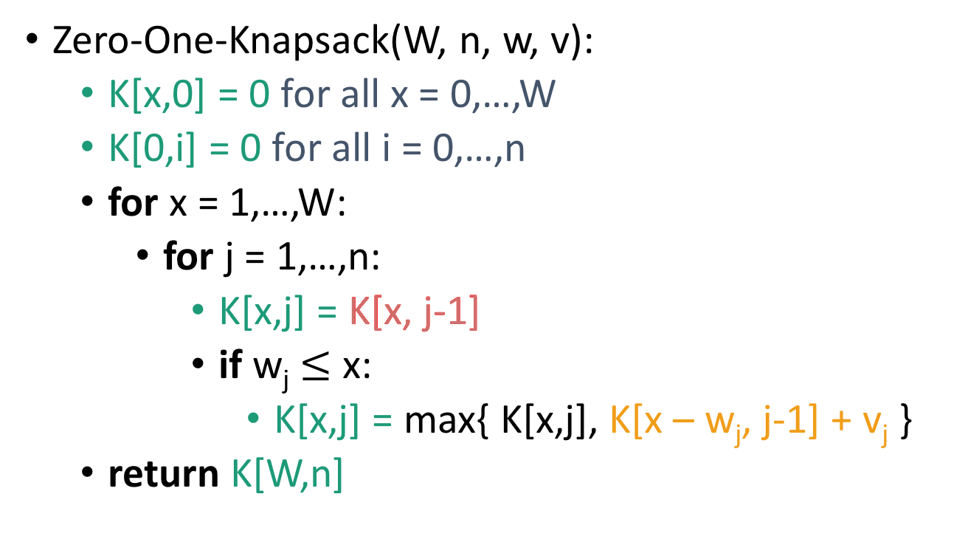
Bottom-up DP algorithm
Zero-One-Knapsack(W, n, w, v):
K[x,0] = 0 for all x = 0,…,W
K[0,i] = 0 for all i = 0,…,n
for x = 1,…,W:
for j = 1,…,n:
K[x,j] = K[x, j-1]
if w_{j} $≤$ x:
K[x,j] = max{ K[x,j], K[x – w_{j}, j-1] + v_{j} }
return K[W,n]
Case 1
Case 2
Running time O(nW)

Slide 22
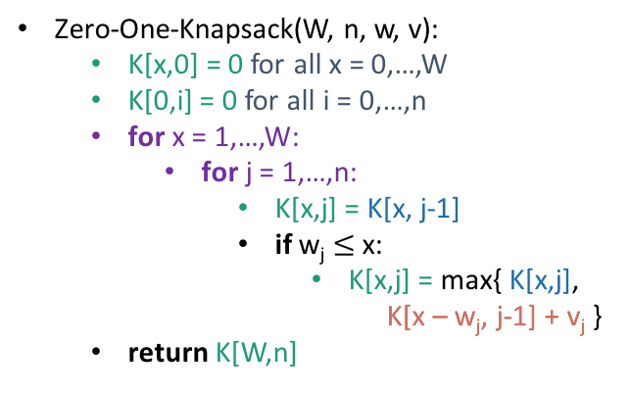
Example
Zero-One-Knapsack(W, n, w, v):
K[x,0] = 0 for all x = 0,…,W
K[0,i] = 0 for all i = 0,…,n
for x = 1,…,W:
for j = 1,…,n:
K[x,j] = K[x, j-1]
if w_{j} $≤$ x:
K[x,j] = max{ K[x,j],
K[x – w_{j}, j-1] + v_{j} }
return K[W,n]
x=0
x=1
x=2
x=3
0
0
0
0
j=0
0
j=1
0
j=2
0
j=3
Item:
current entry
relevant previous entry
Weight:
1
2
3
Value:
1
4
6
Capacity: 3

Slide 23
Example
Zero-One-Knapsack(W, n, w, v):
K[x,0] = 0 for all x = 0,…,W
K[0,i] = 0 for all i = 0,…,n
for x = 1,…,W:
for j = 1,…,n:
K[x,j] = K[x, j-1]
if w_{j} $≤$ x:
K[x,j] = max{ K[x,j],
K[x – w_{j}, j-1] + v_{j} }
return K[W,n]
x=0
x=1
x=2
x=3
0
0
0
0
j=0
0
0
j=1
0
j=2
0
j=3
Item:
current entry
relevant previous entry
Weight:
1
2
3
Value:
1
4
6
Capacity: 3

Slide 24
Example
Zero-One-Knapsack(W, n, w, v):
K[x,0] = 0 for all x = 0,…,W
K[0,i] = 0 for all i = 0,…,n
for x = 1,…,W:
for j = 1,…,n:
K[x,j] = K[x, j-1]
if w_{j} $≤$ x:
K[x,j] = max{ K[x,j],
K[x – w_{j}, j-1] + v_{j} }
return K[W,n]
x=0
x=1
x=2
x=3
0
0
0
0
j=0
0
1
j=1
0
j=2
0
j=3
Item:
current entry
relevant previous entry
Weight:
1
2
3
Value:
1
4
6
Capacity: 3

Slide 25
Example
Zero-One-Knapsack(W, n, w, v):
K[x,0] = 0 for all x = 0,…,W
K[0,i] = 0 for all i = 0,…,n
for x = 1,…,W:
for j = 1,…,n:
K[x,j] = K[x, j-1]
if w_{j} $≤$ x:
K[x,j] = max{ K[x,j],
K[x – w_{j}, j-1] + v_{j} }
return K[W,n]
x=0
x=1
x=2
x=3
0
0
0
0
j=0
0
1
j=1
0
1
j=2
0
j=3
Item:
current entry
relevant previous entry
Weight:
1
2
3
Value:
1
4
6
Capacity: 3

Slide 26
Example
Zero-One-Knapsack(W, n, w, v):
K[x,0] = 0 for all x = 0,…,W
K[0,i] = 0 for all i = 0,…,n
for x = 1,…,W:
for j = 1,…,n:
K[x,j] = K[x, j-1]
if w_{j} $≤$ x:
K[x,j] = max{ K[x,j],
K[x – w_{j}, j-1] + v_{j} }
return K[W,n]
x=0
x=1
x=2
x=3
0
0
0
0
j=0
0
1
j=1
0
1
j=2
0
1
j=3
Item:
current entry
relevant previous entry
Weight:
1
2
3
Value:
1
4
6
Capacity: 3

Slide 27
Example
Zero-One-Knapsack(W, n, w, v):
K[x,0] = 0 for all x = 0,…,W
K[0,i] = 0 for all i = 0,…,n
for x = 1,…,W:
for j = 1,…,n:
K[x,j] = K[x, j-1]
if w_{j} $≤$ x:
K[x,j] = max{ K[x,j],
K[x – w_{j}, j-1] + v_{j} }
return K[W,n]
x=0
x=1
x=2
x=3
0
0
0
0
j=0
0
1
0
j=1
0
1
j=2
0
1
j=3
Item:
current entry
relevant previous entry
Weight:
1
2
3
Value:
1
4
6
Capacity: 3

Slide 28
Example
Zero-One-Knapsack(W, n, w, v):
K[x,0] = 0 for all x = 0,…,W
K[0,i] = 0 for all i = 0,…,n
for x = 1,…,W:
for j = 1,…,n:
K[x,j] = K[x, j-1]
if w_{j} $≤$ x:
K[x,j] = max{ K[x,j],
K[x – w_{j}, j-1] + v_{j} }
return K[W,n]
x=0
x=1
x=2
x=3
0
0
0
0
j=0
0
1
1
j=1
0
1
j=2
0
1
j=3
Item:
current entry
relevant previous entry
Weight:
1
2
3
Value:
1
4
6
Capacity: 3

Slide 29
Example
Zero-One-Knapsack(W, n, w, v):
K[x,0] = 0 for all x = 0,…,W
K[0,i] = 0 for all i = 0,…,n
for x = 1,…,W:
for j = 1,…,n:
K[x,j] = K[x, j-1]
if w_{j} $≤$ x:
K[x,j] = max{ K[x,j],
K[x – w_{j}, j-1] + v_{j} }
return K[W,n]
x=0
x=1
x=2
x=3
0
0
0
0
j=0
0
1
1
j=1
0
1
1
j=2
0
1
j=3
Item:
current entry
relevant previous entry
Weight:
1
2
3
Value:
1
4
6
Capacity: 3

Slide 30
Example
Zero-One-Knapsack(W, n, w, v):
K[x,0] = 0 for all x = 0,…,W
K[0,i] = 0 for all i = 0,…,n
for x = 1,…,W:
for j = 1,…,n:
K[x,j] = K[x, j-1]
if w_{j} $≤$ x:
K[x,j] = max{ K[x,j],
K[x – w_{j}, j-1] + v_{j} }
return K[W,n]
x=0
x=1
x=2
x=3
0
0
0
0
j=0
0
1
1
j=1
0
1
4
j=2
0
1
j=3
Item:
current entry
relevant previous entry
Weight:
1
2
3
Value:
1
4
6
Capacity: 3

Slide 31
Example
Zero-One-Knapsack(W, n, w, v):
K[x,0] = 0 for all x = 0,…,W
K[0,i] = 0 for all i = 0,…,n
for x = 1,…,W:
for j = 1,…,n:
K[x,j] = K[x, j-1]
if w_{j} $≤$ x:
K[x,j] = max{ K[x,j],
K[x – w_{j}, j-1] + v_{j} }
return K[W,n]
x=0
x=1
x=2
x=3
0
0
0
0
j=0
0
1
1
j=1
0
1
4
j=2
0
1
4
j=3
Item:
current entry
relevant previous entry
Weight:
1
2
3
Value:
1
4
6
Capacity: 3

Slide 32
Example
Zero-One-Knapsack(W, n, w, v):
K[x,0] = 0 for all x = 0,…,W
K[0,i] = 0 for all i = 0,…,n
for x = 1,…,W:
for j = 1,…,n:
K[x,j] = K[x, j-1]
if w_{j} $≤$ x:
K[x,j] = max{ K[x,j],
K[x – w_{j}, j-1] + v_{j} }
return K[W,n]
x=0
x=1
x=2
x=3
0
0
0
0
j=0
0
1
1
0
j=1
0
1
4
j=2
0
1
4
j=3
Item:
current entry
relevant previous entry
Weight:
1
2
3
Value:
1
4
6
Capacity: 3

Slide 33
Example
Zero-One-Knapsack(W, n, w, v):
K[x,0] = 0 for all x = 0,…,W
K[0,i] = 0 for all i = 0,…,n
for x = 1,…,W:
for j = 1,…,n:
K[x,j] = K[x, j-1]
if w_{j} $≤$ x:
K[x,j] = max{ K[x,j],
K[x – w_{j}, j-1] + v_{j} }
return K[W,n]
x=0
x=1
x=2
x=3
0
0
0
0
j=0
0
1
1
1
j=1
0
1
4
j=2
0
1
4
j=3
Item:
current entry
relevant previous entry
Weight:
1
2
3
Value:
1
4
6
Capacity: 3

Slide 34
Example
Zero-One-Knapsack(W, n, w, v):
K[x,0] = 0 for all x = 0,…,W
K[0,i] = 0 for all i = 0,…,n
for x = 1,…,W:
for j = 1,…,n:
K[x,j] = K[x, j-1]
if w_{j} $≤$ x:
K[x,j] = max{ K[x,j],
K[x – w_{j}, j-1] + v_{j} }
return K[W,n]
x=0
x=1
x=2
x=3
0
0
0
0
j=0
0
1
1
1
j=1
0
1
4
1
j=2
0
1
4
j=3
Item:
current entry
relevant previous entry
Weight:
1
2
3
Value:
1
4
6
Capacity: 3

Slide 35
Example
Zero-One-Knapsack(W, n, w, v):
K[x,0] = 0 for all x = 0,…,W
K[0,i] = 0 for all i = 0,…,n
for x = 1,…,W:
for j = 1,…,n:
K[x,j] = K[x, j-1]
if w_{j} $≤$ x:
K[x,j] = max{ K[x,j],
K[x – w_{j}, j-1] + v_{j} }
return K[W,n]
x=0
x=1
x=2
x=3
0
0
0
0
j=0
0
1
1
1
j=1
0
1
4
5
j=2
0
1
4
j=3
Item:
current entry
relevant previous entry
Weight:
1
2
3
Value:
1
4
6
Capacity: 3

Slide 36
Example
Zero-One-Knapsack(W, n, w, v):
K[x,0] = 0 for all x = 0,…,W
K[0,i] = 0 for all i = 0,…,n
for x = 1,…,W:
for j = 1,…,n:
K[x,j] = K[x, j-1]
if w_{j} $≤$ x:
K[x,j] = max{ K[x,j],
K[x – w_{j}, j-1] + v_{j} }
return K[W,n]
x=0
x=1
x=2
x=3
0
0
0
0
j=0
0
1
1
1
j=1
0
1
4
5
j=2
0
1
4
5
j=3
Item:
current entry
relevant previous entry
Weight:
1
2
3
Value:
1
4
6
Capacity: 3

Slide 37
Example
Zero-One-Knapsack(W, n, w, v):
K[x,0] = 0 for all x = 0,…,W
K[0,i] = 0 for all i = 0,…,n
for x = 1,…,W:
for j = 1,…,n:
K[x,j] = K[x, j-1]
if w_{j} $≤$ x:
K[x,j] = max{ K[x,j],
K[x – w_{j}, j-1] + v_{j} }
return K[W,n]
x=0
x=1
x=2
x=3
0
0
0
0
j=0
0
1
1
1
j=1
0
1
4
5
j=2
0
1
4
6
j=3
Item:
current entry
relevant previous entry
Weight:
1
2
3
Value:
1
4
6
Capacity: 3

Slide 38
Example
Zero-One-Knapsack(W, n, w, v):
K[x,0] = 0 for all x = 0,…,W
K[0,i] = 0 for all i = 0,…,n
for x = 1,…,W:
for j = 1,…,n:
K[x,j] = K[x, j-1]
if w_{j} $≤$ x:
K[x,j] = max{ K[x,j],
K[x – w_{j}, j-1] + v_{j} }
return K[W,n]
x=0
x=1
x=2
x=3
0
0
0
0
j=0
0
1
1
1
j=1
0
1
4
5
j=2
So the optimal solution is to put one watermelon in your knapsack!
0
1
4
6
j=3
Item:
current entry
relevant previous entry
Weight:
1
2
3
Value:
1
4
6
Capacity: 3

Slide 39
Recipe for applying Dynamic Programming
Step 1: Identify optimal substructure.
Step 2: Find a recursive formulation for the value of the optimal solution.
Step 3: Use dynamic programming to find the value of the optimal solution.
Step 4: If needed, keep track of some additional info so that the algorithm from Step 3 can find the actual solution.
Step 5: If needed, code this up like a reasonable person.
You do this one!
(We did it on the slide in the previous example, just not in the pseudocode!)

Slide 40
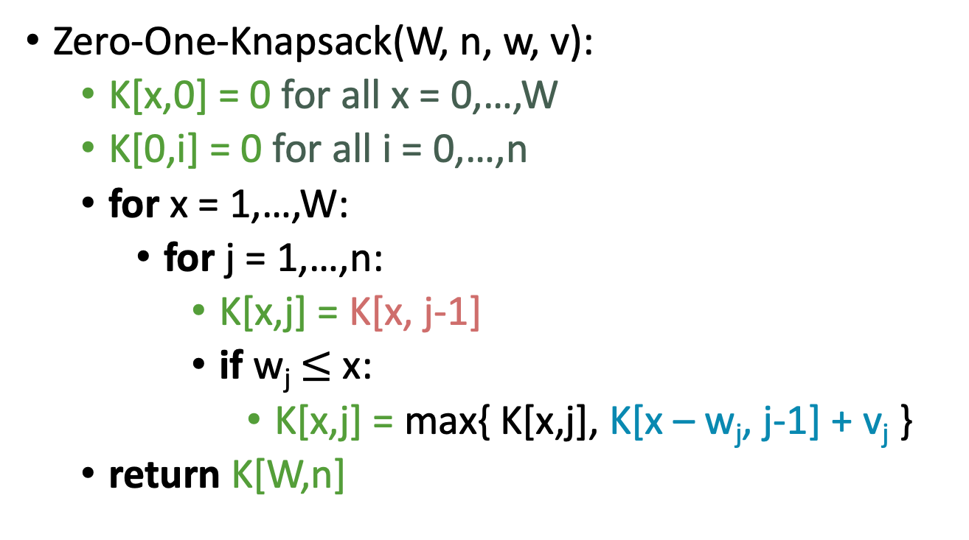
What have we learned?
0-1背包问题
If there are n items and our knapsack has capacity W.
2D Cost函数，2D计算
K[x,j] = max{ K[x, j-1] , K[x – w_{j,} j-1] + v_{j} }
Zero-One-Knapsack(W, n, w, v):
K[x,0] = 0 for all x = 0,…,W
K[0,i] = 0 for all i = 0,…,n
for x = 1,…,W:
for j = 1,…,n:
K[x,j] = K[x, j-1]
if w_{j} $≤$ x:
K[x,j] = max{ K[x,j], K[x – w_{j}, j-1] + v_{j} }
return K[W,n]
Running time: O(nW)

Slide 41
Question
How did we know which substructure to use in which variant of knapsack?
Answer in retrospect:
This one made sense for unbounded knapsack because it doesn’t have any memory of what items have been used.
vs.
In 0/1 knapsack, we can only use each item once, so it makes sense to leave out one item at a time.
Operational Answer: try some stuff, see what works!

Slide 42
主要内容
0-1 Knapsack Problem
2D数组表示，2D计算
Maximal Independent Set, Minimal Cover
树上的动态规划
Floyd-Warshall Algorithm
图上的动态规划
NP-hard problem

Slide 43
Independent Set
2
2
2
1
1
2
An independent set is a set of vertices so that no pair has an edge between them.
3
Given a graph with weights on the vertices…
What is the independent set with the largest weight?
5
5
1
1

Slide 44
Actually, this problem is NP-complete. So, we are unlikely to find an efficient algorithm.
But if we also assume that the graph is a tree…
3
2
3
3
3
5
5
A tree is a connected graph with no cycles.
2
3
1
2
5
5
5
2
5
2
Problem:
find a maximal independent set in a tree (with vertex weights).

Slide 45
Recipe for applying Dynamic Programming
Step 1: Identify optimal substructure.
Step 2: Find a recursive formulation for the value of the optimal solution
Step 3: Use dynamic programming to find the value of the optimal solution
Step 4: If needed, keep track of some additional info so that the algorithm from Step 3 can find the actual solution.
Step 5: If needed, code this up like a reasonable person.

Slide 46
Optimal substructure
Subtrees are a natural candidate.
There are two cases:
The root of this tree is not in a maximal independent set.
Or it is.

Slide 47
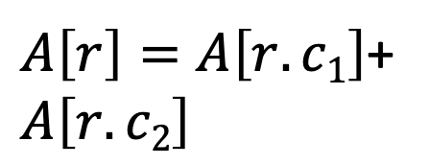
Case 1: the root is not in a maximal independent set
r
Use the optimal solution from these smaller problems.
$A\left[r\right]=A\left[r.c1\right]$+ $A\left[r.c2\right]$
r.c₁
r.c₂

Slide 48
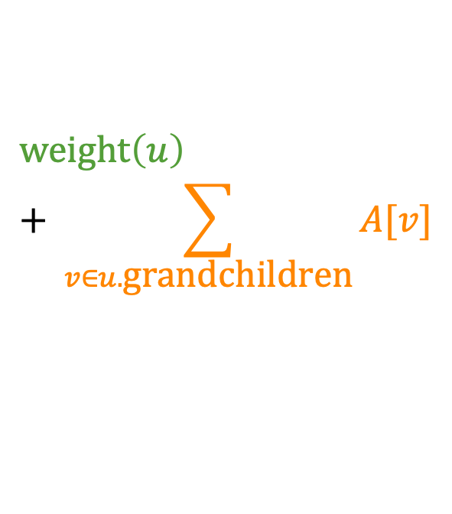
Case 2: the root is in an maximal independent set
Then its children can’t be.
Below that, use the optimal solution from these smaller subproblems.
$$\text{weight}\left(u\right)+ \sum_{v∈u.\text{grandchildren}}{A[v]}$$

Slide 49
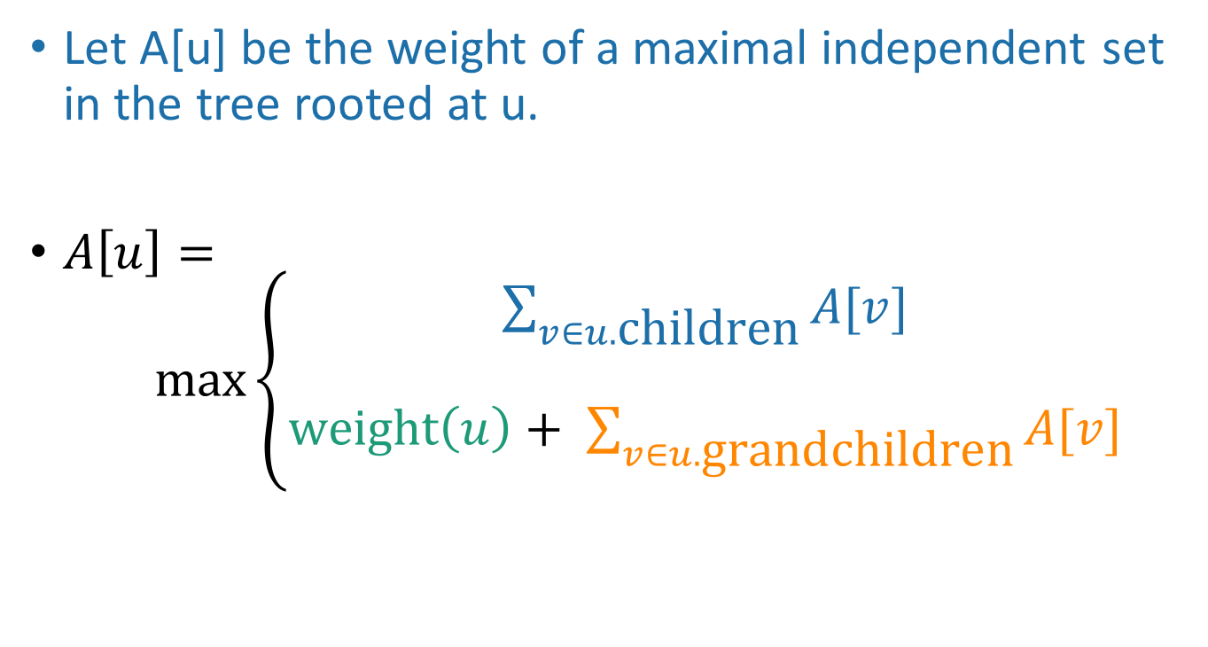
Recursive formulation: try 1
Let A[u] be the weight of a maximal independent set in the tree rooted at u.
$A\left[u\right]= \max\left\{\begin{aligned}\sum_{v∈u.\text{children}}{A[v]} \\ \\ \text{weight}\left(u\right)+ \sum_{v∈u.\text{grandchildren}}{A[v]}\end{aligned}\right.$
When we implement this, how do we keep track of this term?

Slide 50
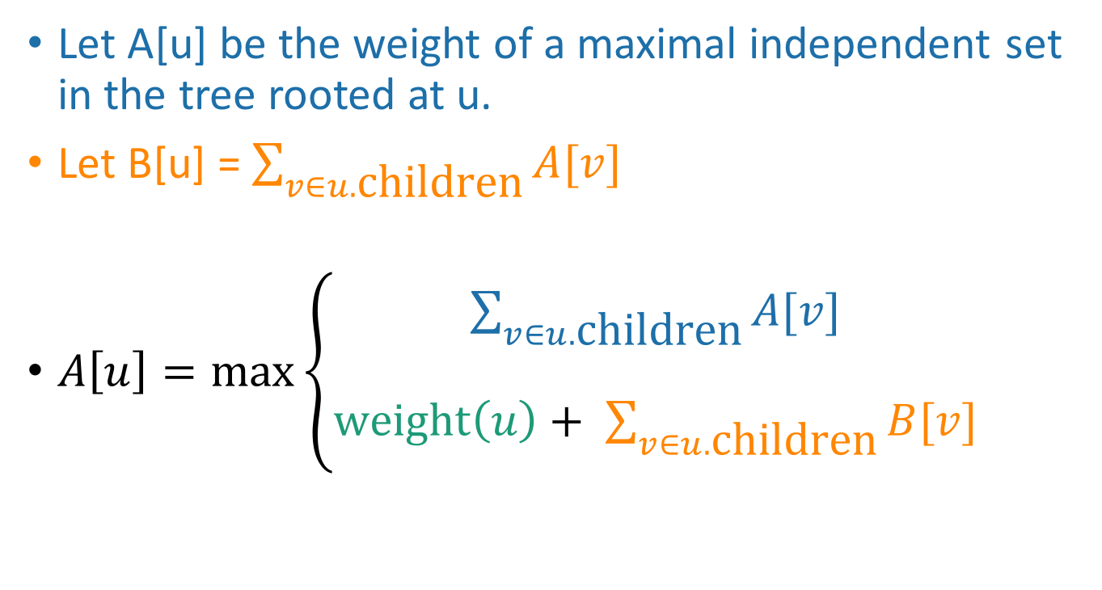
Recursive formulation: try 2 Keep two arrays!
Let A[u] be the weight of a maximal independent set in the tree rooted at u.
Let B[u] = $\sum_{v∈u.\text{children}}{A[v]}$
$A\left[u\right]=\max\left\{\begin{aligned}\sum_{v∈u.\text{children}}{A[v]} \\ \\ \text{weight}\left(u\right)+ \sum_{v∈u.\text{children}}{B[v]}\end{aligned}\right.$

Slide 51
Recipe for applying Dynamic Programming
Step 1: Identify optimal substructure.
Step 2: Find a recursive formulation for the value of the optimal solution.
Step 3: Use dynamic programming to find the value of the optimal solution.
Step 4: If needed, keep track of some additional info so that the algorithm from Step 3 can find the actual solution.
Step 5: If needed, code this up like a reasonable person.

Slide 52
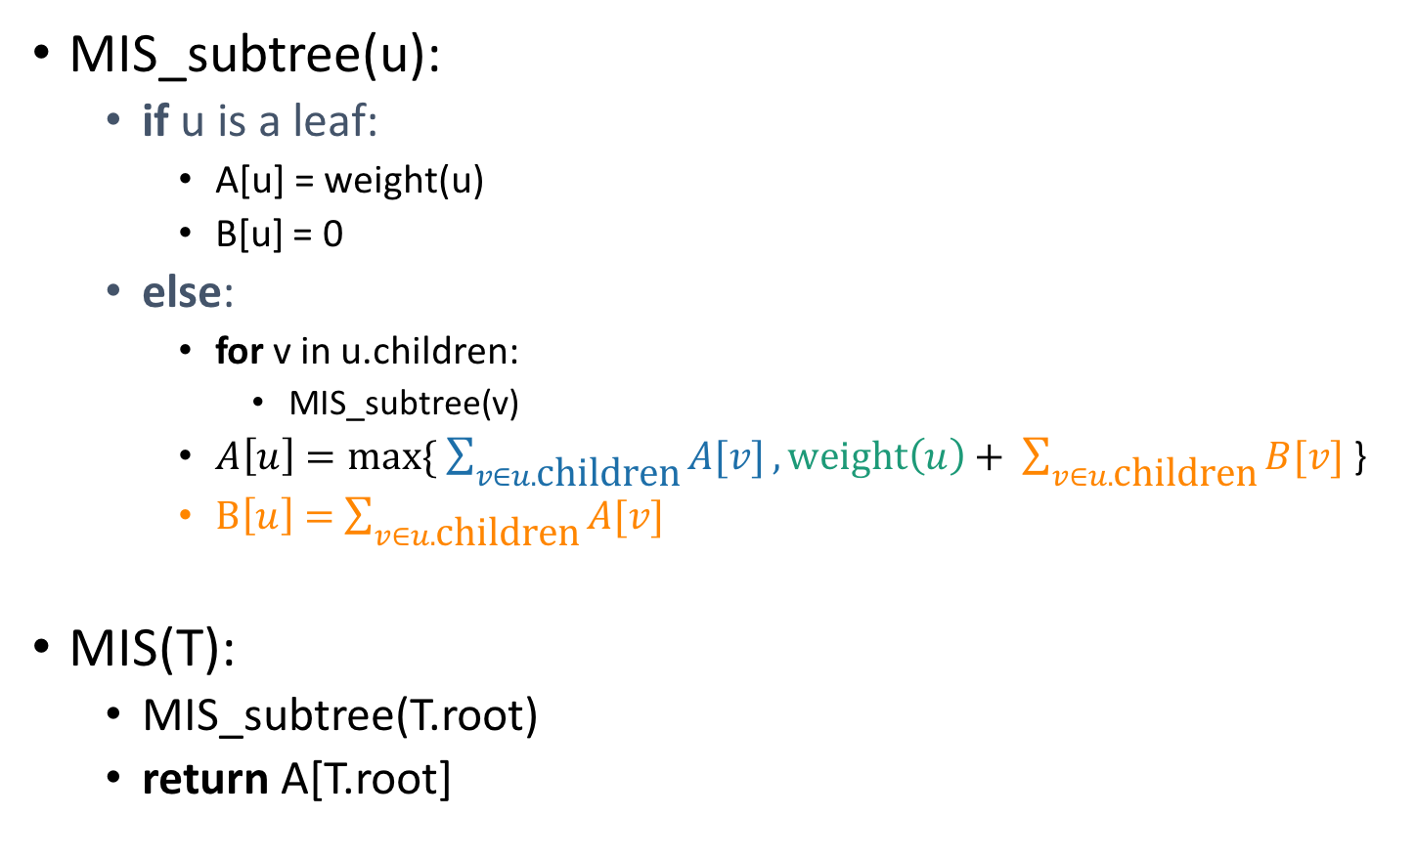
A top-down DP algorithm
MIS_subtree(u):
if u is a leaf:
A[u] = weight(u)
B[u] = 0
else:
for v in u.children:
MIS_subtree(v)
$A\left[u\right]=max⁡\{ \sum_{v∈u.\text{children}}{A[v]},\text{weight}\left(u\right)+ \sum_{v∈u.\text{children}}{B[v]}$ }
$B\left[u\right]=$ $\sum_{v∈u.\text{children}}{A[v]}$
MIS(T):
MIS_subtree(T.root)
return A[T.root]
Initialize global arrays A, B that we will use in all of the recursive calls.
Running time?
We visit each vertex once, and for every vertex we do O(1) work:
Make a recursive call
Participate in summations of parent node
Running time is O(|V|)

Slide 53
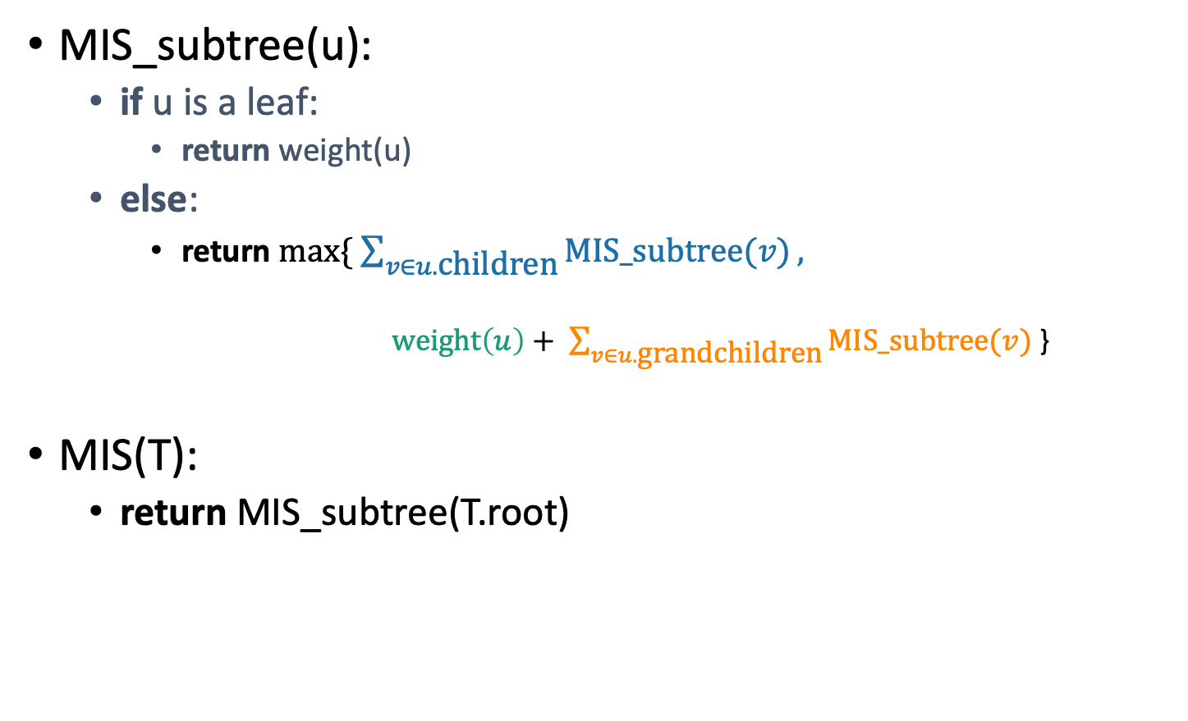
Why is this different from divide-and-conquer? That’s always worked for us with tree problems before…
MIS_subtree(u):
if u is a leaf:
return weight(u)
else:
return $max⁡\{ \sum_{v∈u.\text{children}}{MIS_subtree(v)},$
$\text{weight}\left(u\right)+ \sum_{v∈u.\text{grandc}\text{hildren}}{MIS_subtree(v)}$ }
MIS(T):
return MIS_subtree(T.root)
This is exactly the same pseudocode, except we’ve ditched the table and are just calling MIS_subtree(v) instead of looking up A[v] or B[v].
在分治递归算法中，由于分治出来的子问题不重叠，我们可以不做存储，直接计算子问题，然后再递归的返回上层问题。

Slide 54
Why is this different from divide-and-conquer? That’s always worked for us with tree problems before…
How often would we ask about the subtree rooted here?
Once for this node and once for this one.
But we then ask about this node twice, here and here.
This will blow up exponentially without using dynamic programming to take advantage of overlapping subproblems.

Slide 55
Recipe for applying Dynamic Programming
Step 1: Identify optimal substructure.
Step 2: Find a recursive formulation for the value of the optimal solution.
Step 3: Use dynamic programming to find the value of the optimal solution.
Step 4: If needed, keep track of some additional info so that the algorithm from Step 3 can find the actual solution.
Step 5: If needed, code this up like a reasonable person.
You do this one!

Slide 56
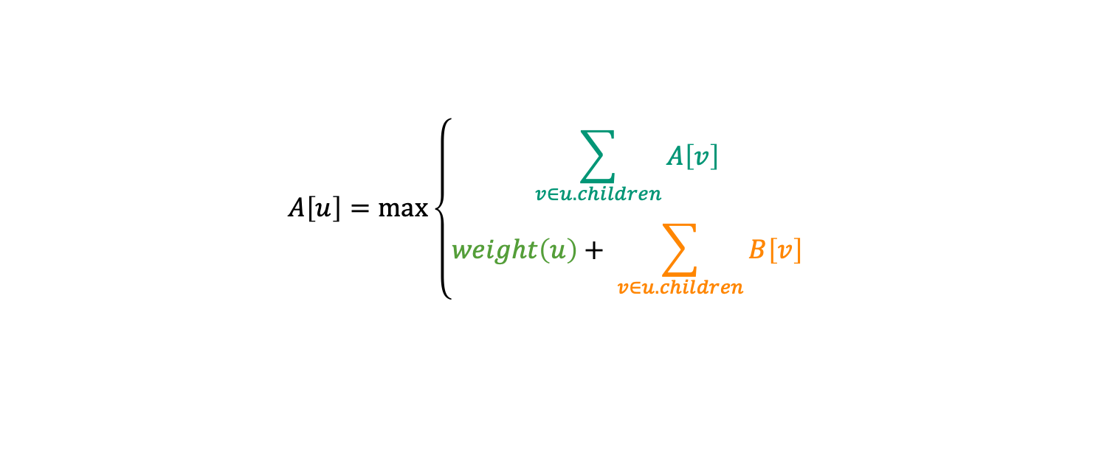
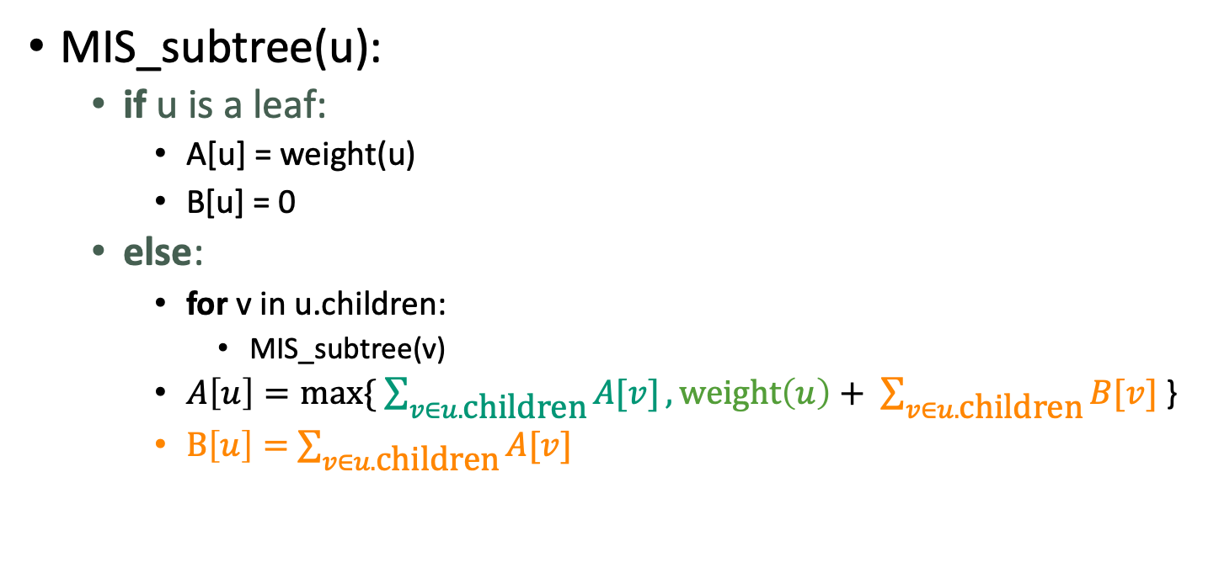
What have we learned?
最大独立集问题：
1D Cost 函数，通过迭代两个1D数组计算：
$$A\left[u\right]=\max\left\{\begin{aligned}\sum_{v∈u.children}{A\left[v\right]} \\ \\ weight\left(u\right)+ \sum_{v∈u.children}{B\left[v\right]}\end{aligned}\right.$$
MIS_subtree(u):
if u is a leaf:
A[u] = weight(u)
B[u] = 0
else:
for v in u.children:
MIS_subtree(v)
$A\left[u\right]=max⁡\{ \sum_{v∈u.\text{children}}{A[v]},\text{weight}\left(u\right)+ \sum_{v∈u.\text{children}}{B[v]}$ }
$B\left[u\right]=$ $\sum_{v∈u.\text{children}}{A[v]}$
Running time: O(|V|)

Slide 57
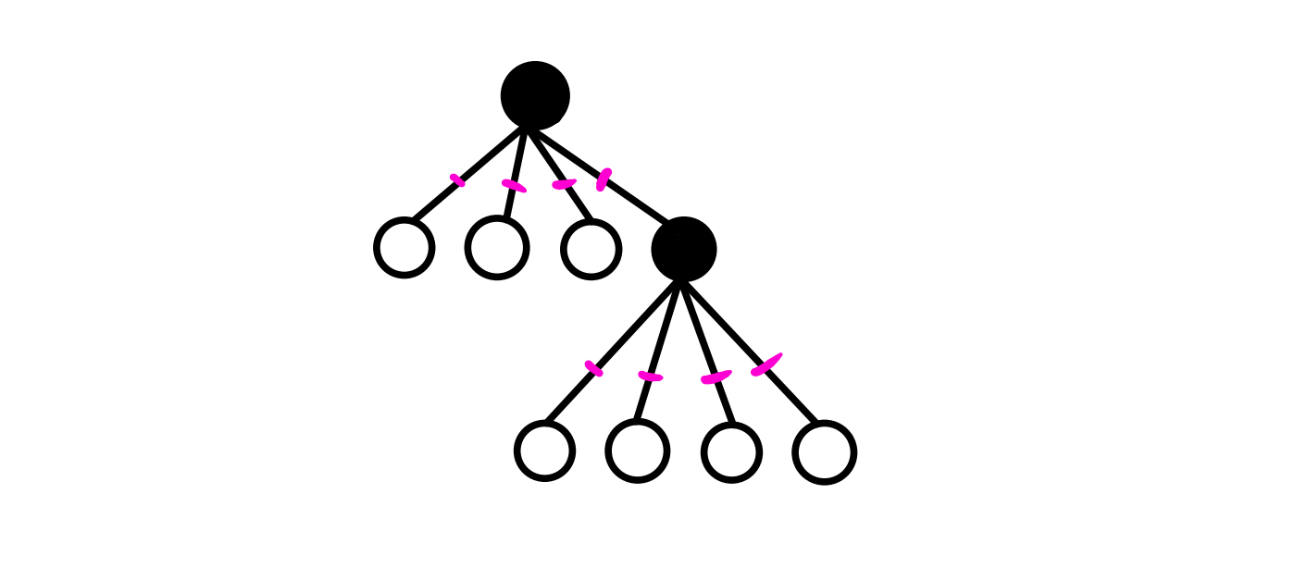
Dynamic Programming Problems on Trees
树的最小顶点覆盖
给你一个有 n 个点的树，每两个点之间至多只有一条边。如果在一个节点上放一个宝石，那他能覆盖与之相连的边，问最少放多少宝石，才能把所有的边覆盖住。

Slide 58
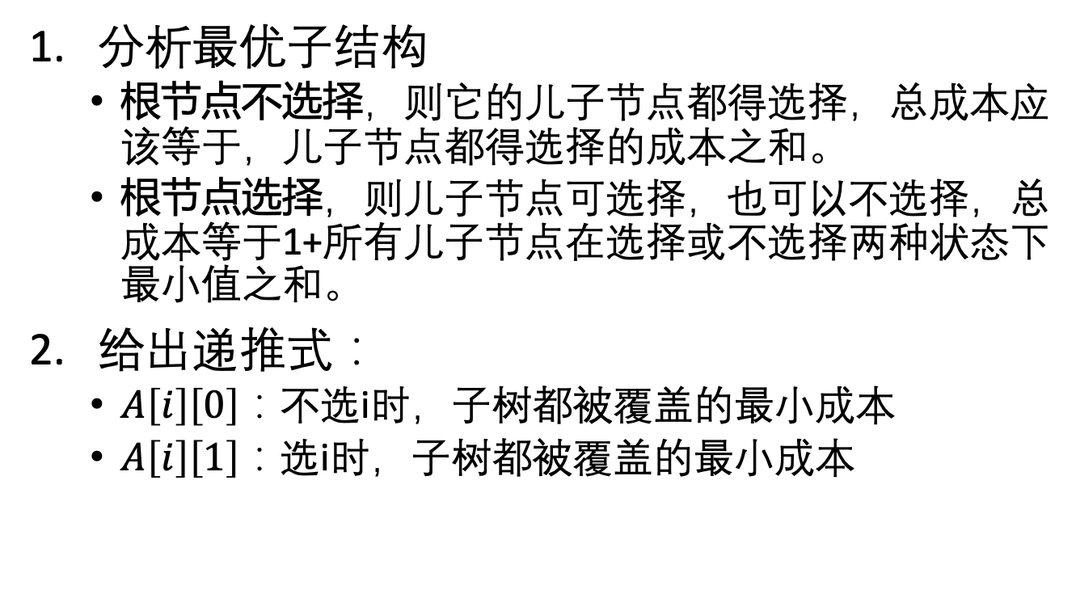
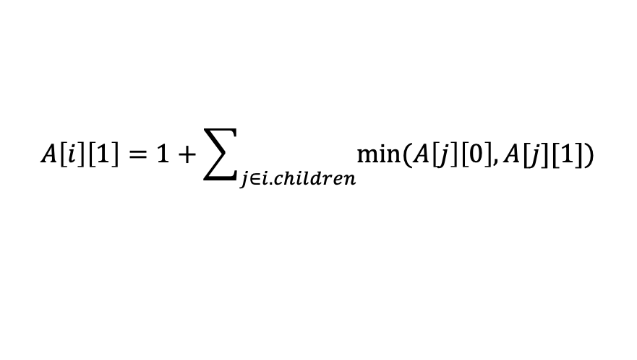
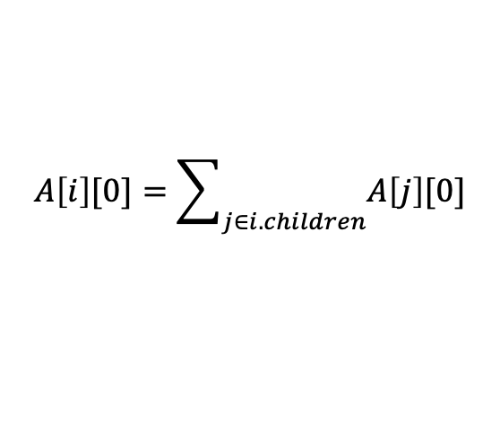
树的最小顶点覆盖
分析最优子结构
根节点不选择，则它的儿子节点都得选择，总成本应该等于，儿子节点都得选择的成本之和。
根节点选择，则儿子节点可选择，也可以不选择，总成本等于1+所有儿子节点在选择或不选择两种状态下最小值之和。
给出递推式：
$A\left[i\right]\left[0\right]$：不选i时，子树都被覆盖的最小成本
$A\left[i\right]\left[1\right]$：选i时，子树都被覆盖的最小成本
$$A\left[i\right][0]=\sum_{j∈i.children}{A\left[j\right][0]}$$
$$A\left[i\right]\left[1\right]=1+\sum_{j∈i.children}{min⁡(A\left[j\right]\left[0\right], A[j][1])}$$

Slide 59
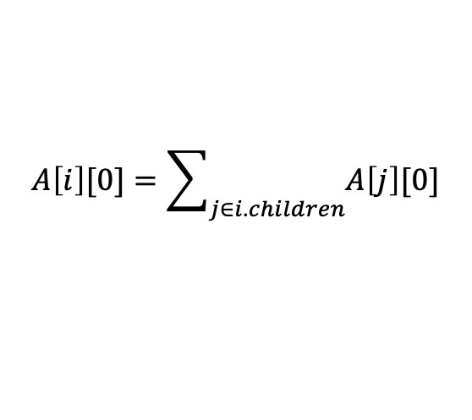
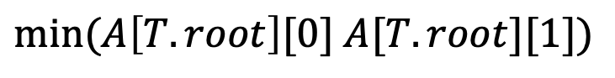
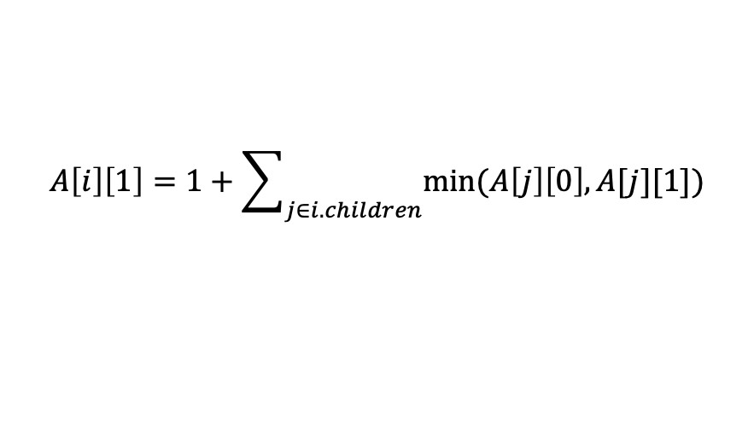
树的最小顶点覆盖
$$A\left[i\right][0]=\sum_{j∈i.children}{A\left[j\right][0]}$$
$$A\left[i\right]\left[1\right]=1+\sum_{j∈i.children}{min⁡(A\left[j\right]\left[0\right], A[j][1])}$$
以T为根的树的最小覆盖
$$min⁡(A\left[T.root\right][0] A[T.root][1])$$
Running time: O(|V|)

Slide 60
主要内容
0-1 Knapsack Problem
2D数组表示，2D计算
Maximal Independent Set
树上的动态规划
Floyd-Warshall Algorithm
图上的动态规划
Bellman Ford Algorithm
图上的动态规划

Slide 61
Bellman-Ford Algorithm
Input: Directed graph G = (V,E), edge lengths c_{e} for each e ∈ E, source vertex s ∈ V .
Goal: For every destination v ∈ V , compute the length (sum of edge costs) of a shortest s-v path.
Dijkstra’s Algorithm: O(m log n) running time using heaps (n = number of vertices, m = number of edges)
Not always correct with negative edge lengths

Slide 62
Bellman-Ford Algorithm
Optimal Substructure
Key idea: Artificially restrict the number of edges in a path.
Subproblem size ⇐⇒ Number of permitted edges
Example:

Slide 63
Bellman-Ford Algorithm
For every v ∈ V, i ∈ {1,2,...}, let P = shortest s-v path with at most i edges. (Cycles are permitted.)
Case1: If P has ≤(i−1) edges, it is a shortest s-v path with ≤ (i − 1) edges.
Case 2: If P has i edges with last hop (w,v), then P′ is a shortest s-w path with ≤ (i − 1) edges.

Slide 64
递推关系
Notation: Let L_{i,v} = minimum length of a s-v path with ≤ i edges.
With cycles allowed
Defined as +∞ if no s-v paths with ≤ i edges
Recurrence: For every v ∈ V, i ∈ {1,2,...}
If G has no negative cycle, only need to solve subproblems up to i = n − 1.

Slide 65
The Bellman-Ford Algorithm
Let A = 2-D array (indexed by i and v)
Base case: A[0,s] = 0; A[0,v] = +∞ for all v ̸= s.
For i = 1, 2, . . . , n − 1
For each v ∈ V
As discussed: If G has no negative cycle, then algorithm is correct with final answers = A[n − 1, v ].
Running time: O(nm)

Slide 66
Early Stop and Negative Circle
Note: Suppose for some j<n−1, A[j,v]=A[j−1,v] for all vertices v.
For all v, all future A[i,v]’s will be the same
Can safely halt (since A[n − 1, v ]’s = correct shortest-path distances)
G has no negative-cost cycle (that is reachable from s) ⇐⇒ In the extended Bellman-Ford algorithm, A[n − 1, v ] = A[n, v ] for all v∈V.
Consequence: check for a negative cycle just by running Bellman-Ford for one extra iteration (running time still O(mn)).

Slide 67
The Bellman-Ford Algorithm
2D Cost函数，2D计算
For i = 1, 2, . . . , n − 1
For each v ∈ V
Running time: O(mn)

Slide 68
主要内容
0-1 Knapsack Problem
2D数组表示，2D计算
Maximal Independent Set
树上的动态规划
Floyd-Warshall Algorithm
图上的动态规划
Bellman Ford Algorithm
图上的动态规划

Slide 69
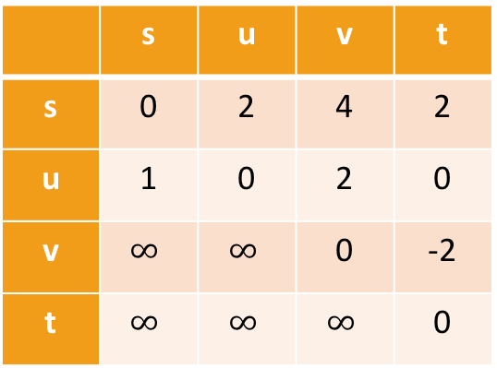
Floyd-Warshall Algorithm Another example of DP
This is an algorithm for All-Pairs Shortest Paths (APSP)
That is, I want to know the shortest path from u to v for ALL pairs u,v of vertices in the graph.
Not just from a special single source s.
Destination
Source
 | s | u | v | t
s | 0 | 2 | 4 | 2
u | 1 | 0 | 2 | 0
v | $$∞$$ | $$∞$$ | 0 | -2
t | $$∞$$ | $$∞$$ | $$∞$$ | 0
s
2
u
1
5
2
t
v
-2

Slide 70
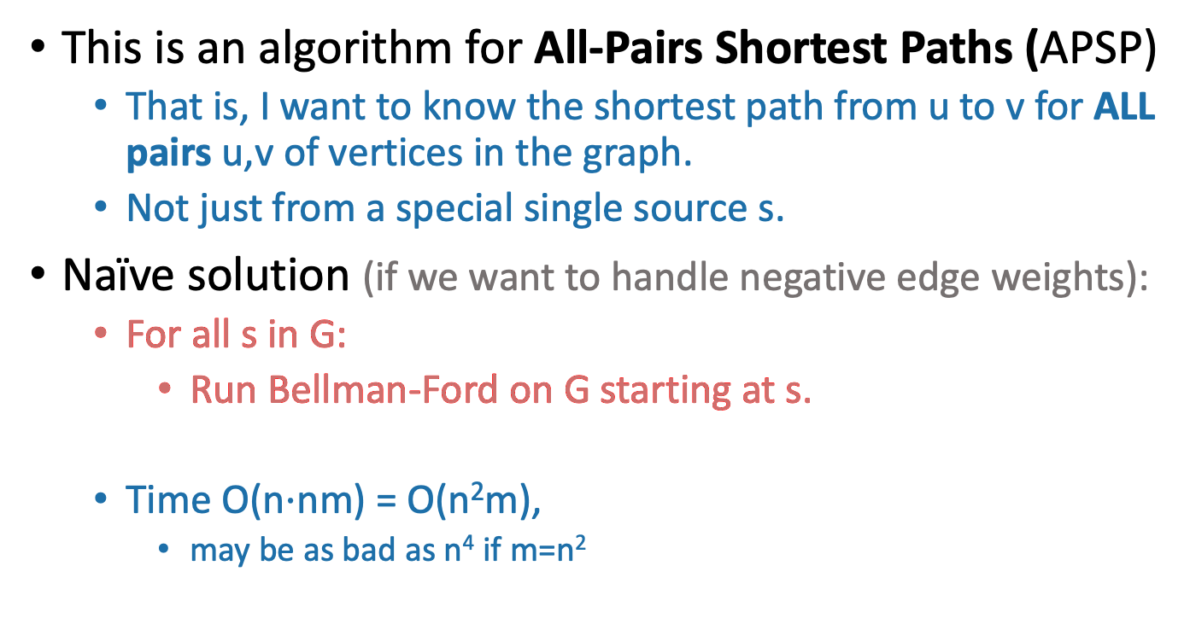
Floyd-Warshall Algorithm Another example of DP
This is an algorithm for All-Pairs Shortest Paths (APSP)
That is, I want to know the shortest path from u to v for ALL pairs u,v of vertices in the graph.
Not just from a special single source s.
Naïve solution (if we want to handle negative edge weights):
For all s in G:
Run Bellman-Ford on G starting at s.
Time O(n$⋅$nm) = O(n²m),
may be as bad as n⁴ if m=n²
Can we do better?

Slide 71
Optimal substructure
Label the vertices 1,2,…,n
k
k+1
u
1
2
v
3
…
k-1
n

Slide 72
Optimal substructure
Label the vertices 1,2,…,n
(We omit some edges in the picture below – meant to be a cartoon, not an example).
Sub-problem(k-1):
For all pairs, u,v, find the cost of the shortest path from u to v, so that all the internal vertices on that path are in {1,…,k-1}.
Our DP algorithm will fill in the
n-by-n arrays
D⁽⁰⁾, D⁽¹⁾, …, D^{(n)} iteratively and then we’ll be done.
k
Let D^{(k-1)}[u,v] be the solution to Sub-problem(k-1).
k+1
u
1
2
v
3
…
k-1
This is the shortest path from u to v through the blue set. It has cost D^{(k-1)}[u,v]
n
Vertices 1, …, k-1

Slide 73
Optimal substructure
Label the vertices 1,2,…,n
(We omit some edges in the picture below – meant to be a cartoon, not an example).
Sub-problem(k-1):
For all pairs, u,v, find the cost of the shortest path from u to v, so that all the internal vertices on that path are in {1,…,k-1}.
Our DP algorithm will fill in the
n-by-n arrays
D⁽⁰⁾, D⁽¹⁾, …, D^{(n)} iteratively and then we’ll be done.
k
Let D^{(k-1)}[u,v] be the solution to Sub-problem(k-1).
k+1
Question: How can we find D^{(k)}[u,v] using D^{(k-1)}?
u
1
2
v
3
…
k-1
This is the shortest path from u to v through the blue set. It has cost D^{(k-1)}[u,v]
n
Vertices 1, …, k-1

Slide 74
How can we find D^{(k)}[u,v] using D^{(k-1)}?
D^{(k)}[u,v] is the cost of the shortest path from u to v so that all internal vertices on that path are in {1, …, k}.
k
k+1
Vertices 1, …, k
u
1
2
v
3
…
k-1
n
Vertices 1, …, k-1

Slide 75
How can we find D^{(k)}[u,v] using D^{(k-1)}?
D^{(k)}[u,v] is the cost of the shortest path from u to v so that all internal vertices on that path are in {1, …, k}.
Case 1: we don’t need vertex k.
k
k+1
Vertices 1, …, k
u
1
2
v
3
…
k-1
This path was the shortest before, so it’s still the shortest now.
n
Vertices 1, …, k-1
D^{(k)}[u,v] = D^{(k-1)}[u,v]

Slide 76
How can we find D^{(k)}[u,v] using D^{(k-1)}?
D^{(k)}[u,v] is the cost of the shortest path from u to v so that all internal vertices on that path are in {1, …, k}.
Case 2: we need vertex k.
k
k+1
Vertices 1, …, k
u
1
2
v
3
…
k-1
n
Vertices 1, …, k-1

Slide 77
Case 2 continued
Suppose there are no negative cycles.
Then WLOG the shortest path from u to v through {1,…,k} is simple.
If that path passes through k, it must look like this:
This path is the shortest path from u to k through {1,…,k-1}.
sub-paths of shortest paths are shortest paths
Similarly for this path.
Case 2: we need vertex k.
k
Vertices 1, …, k
u
1
2
v
3
…
k-1
n
Vertices 1, …, k-1
D^{(k)}[u,v] = D^{(k-1)}[u,k] + D^{(k-1)}[k,v]

Slide 78
How can we find D^{(k)}[u,v] using D^{(k-1)}?
Case 1: we don’t need vertex k.
Case 2: we need vertex k.
k
k
Vertices 1, …, k
Vertices 1, …, k
u
1
u
1
2
2
v
v
3
3
…
…
k-1
k-1
Vertices 1, …, k-1
Vertices 1, …, k-1
D^{(k)}[u,v] = D^{(k-1)}[u,v]
D^{(k)}[u,v] = D^{(k-1)}[u,k] + D^{(k-1)}[k,v]

Slide 79
How can we find D^{(k)}[u,v] using D^{(k-1)}?
D^{(k)}[u,v] = min{ D^{(k-1)}[u,v], D^{(k-1)}[u,k] + D^{(k-1)}[k,v] }
Optimal substructure:
We can solve the big problem using solutions to smaller problems.
Overlapping sub-problems:
D^{(k-1)}[k,v] can be used to help compute D^{(k)}[u,v] for lots of different u’s.
Case 1: Cost of shortest path through {1,…,k-1}
Case 2: Cost of shortest path from u to k and then from k to v through {1,…,k-1}

Slide 80
How can we find D^{(k)}[u,v] using D^{(k-1)}?
D^{(k)}[u,v] = min{ D^{(k-1)}[u,v], D^{(k-1)}[u,k] + D^{(k-1)}[k,v] }
Using our Dynamic programming paradigm, this immediately gives us an algorithm!
Case 1: Cost of shortest path through {1,…,k-1}
Case 2: Cost of shortest path from u to k and then from k to v through {1,…,k-1}

Slide 81
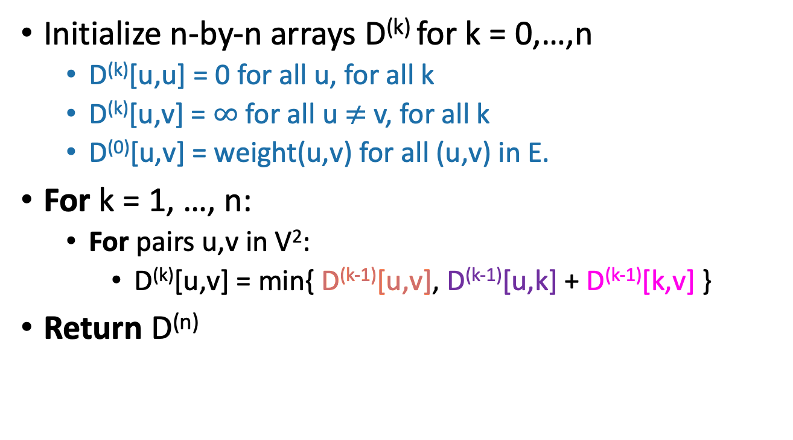
Floyd-Warshall algorithm
Initialize n-by-n arrays D^{(k)} for k = 0,…,n
D^{(k)}[u,u] = 0 for all u, for all k
D^{(k)}[u,v] = $∞$ for all u $≠$ v, for all k
D⁽⁰⁾[u,v] = weight(u,v) for all (u,v) in E.
For k = 1, …, n:
For pairs u,v in V²:
D^{(k)}[u,v] = min{ D^{(k-1)}[u,v], D^{(k-1)}[u,k] + D^{(k-1)}[k,v] }
Return D^{(n)}
The base case checks out: the only path through zero other vertices are edges directly from u to v.
This is a bottom-up Dynamic programming algorithm.

Slide 82
We’ve basically just shown
Theorem:
If there are no negative cycles in a weighted directed graph G, then the Floyd-Warshall algorithm, running on G, returns a matrix D^{(n)} so that:
D^{(n)}[u,v] = distance between u and v in G.
Running time: O(n³)
Better than running Bellman-Ford n times!
Storage:
Need to store two n-by-n arrays, and the original graph.
Work out the details of a proof!
We don’t even need two, just one array is fine. Why?
As with Bellman-Ford, we don’t really need to store all n of the D^{(k)}.

Slide 83
What if there are negative cycles?
Just like Bellman-Ford, Floyd-Warshall can detect negative cycles:
“Negative cycle” means that there’s some v so that there is a path from v to v that has cost < 0.
Aka, D^{(n)}[v,v] < 0.
Algorithm:
Run Floyd-Warshall as before.
If there is some v so that D^{(n)}[v,v] < 0:
return negative cycle.

Slide 84
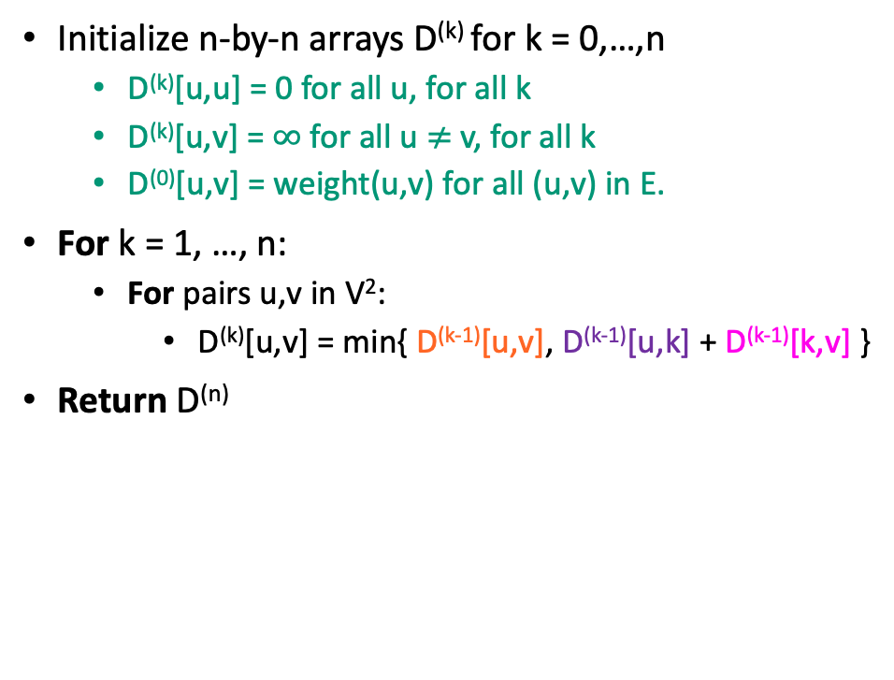
What have we learned?
The Floyd-Warshall algorithm is another example of dynamic programming.
3D cost函数，3D计算
D^{(k)}[u,v] = min{ D^{(k-1)}[u,v], D^{(k-1)}[u,k] + D^{(k-1)}[k,v] }
Initialize n-by-n arrays D^{(k)} for k = 0,…,n
D^{(k)}[u,u] = 0 for all u, for all k
D^{(k)}[u,v] = $∞$ for all u $≠$ v, for all k
D⁽⁰⁾[u,v] = weight(u,v) for all (u,v) in E.
For k = 1, …, n:
For pairs u,v in V²:
D^{(k)}[u,v] = min{ D^{(k-1)}[u,v], D^{(k-1)}[u,k] + D^{(k-1)}[k,v] }
Return D^{(n)}
Running time: O(n³)

Slide 85
Can we do better than O(n³)? Nothing on this slide is required knowledge for this class
There is an algorithm that runs in time O(n³/log¹⁰⁰(n)).
[Williams, “Faster APSP via Circuit Complexity”, STOC 2014]
If you can come up with an algorithm for All-Pairs-Shortest-Path that runs in time O(n^{2.99}), that would be a really big deal.
Let me know if you can!
See [Abboud, Vassilevska-Williams, “Popular conjectures imply strong lower bounds for dynamic problems”, FOCS 2014] for some evidence that this is a very difficult problem!

Slide 86
总结
问题 | 方法 | 时间复杂度
加权区间调度 | 1D cost, 1维计算 | O(n)
无限背包 | 1D cost, 2D计算 | O(nW)
最长公共子序列 | 2D cost, 2D计算 | O(mn)
矩阵链乘 | 2D cost, 3D计算 | O(n³)
0-1背包 | 2D cost, 2D计算 | O(nW)
最大独立集 | 1D cost, 1D计算 | O(|V|)
最小顶点覆盖 | 2D cost, 1D计算 | O(|V|)
Bellman Ford 最短路 | 2D cost, 2D计算 | O(mn)
Floyd Warshall 多对多最短路 | 3D cost, 3D计算 | O(n³)

